Slide 1
New Requirements
For
Soil Fumigant Pesticide Products
EPA and UGA Grower Trainings
Nov 2010
Culpepper and Sumner
Notes:
This is the first in a series of training modules on new requirements for use of soil fumigant products.

Slide 2
Reregistration Eligibility Decisions
“REDs”
Re-licensing decisions for chemicals used as soil fumigants
  Methyl Bromide
  Chloropicrin
  Metam Sodium/Metam Potassium
  Dazomet
CHANGES BEGIN WITH NEW LABELS EXPECTED AROUND DECEMBER 1, 2010
2
2
Module 1: The EPA Regulatory Process
Notes:
2
2
The chemicals included in the soil fumigant group review are listed on the slide.
This was the first time EPA conducted a comprehensive re-evaluation of these soil fumigants.
Some of the products had very old registrations, and soil fumigant products were among the last chemicals to go through reregistration.
Residential bystander along with worker concerns were identified in the science review; Module 3 provides more details about the risks.
*1,3-Dichloropropene completed reregistration in 1998
*Iodomethane was registered in 2007

Slide 3
Goals of Mitigation Measures
Package of measures that work together to:
Reduce
  potential for direct exposure to toxic concentrations
  likelihood of accidents and errors
Foster planning and compliance
Assure appropriate response to exposures
3
3
Module 1: The EPA Regulatory Process
Notes:
3
3
The goals were developed as a package. No single mitigation measure addresses all of the risks alone.
During the comment periods on the REDs, many people expected that buffer zones would be the answer to risk concerns. However, it was clear to EPA that to make buffer zones protective in all situations, they would need to be very large– bigger than would be practical.
So, based on comments, EPA adopted a package approach where all of the measures would work together to achieve safety goals while also avoiding huge buffers that would be impractical.
The measures work together to address risks by
- Reducing potential for direct exposure to toxic concentrations
- Reducing likelihood of accidents and errors
- Fostering planning and compliance, and
- Assuring appropriate response to exposures that occur
Regarding appropriate response, although we are confident that in the future there will be far fewer exposures, we all know sometimes things go wrong.
When that happens, an appropriate response is critical– one that makes things better and not worse.

Slide 4
Implementation Schedule
Risk Mitigation Measure | 2010 | 2011
Good agricultural practices (GAPs) | ● | ●
Restricted use (new measure for metam sodium/ potassium & dazomet only) | ● | ●
New handler protections including changes to respiratory protection, tarp cutting/removal and worker reentry restrictions | ● | ●
Fumigant management plans and post application summaries | ●/◙ | ●
Buffer zone distances, credits, and posting |  | ●
Emergency preparedness measures |  | ●
Difficult to evacuate sites |  | ●
Notice to state lead agencies |  | ●
Safe handling information | ● | ●
First responder, community outreach and certified applicator training | ◙ | ●
Rate reductions and use site limitations | ● | ●
◙ under
development
● adopt
4
Module 1: Outreach & Implementation
Notes:
4
Next, I’ll cover the implementation schedule.
Public comments, especially from users and industry, showed concern about all of these changes happening at once.
Based on those comments, EPA decided to delay implementation of the more challenging aspects of the decisions so that EPA, states, and stakeholder groups would be able to conduct outreach before measures appear on labels in the field.
So when the amended REDs were issued in 2009, EPA announced that the measures to be implemented in the first phase in 2010 would be those that can be clearly and effectively communicated in labeling—for example, rate reductions, use of best practices, worker protection measures, and plans for safe, effective fumigations.
The more challenging measures, for example buffer zones and related measures, would be implemented in phase 2, in 2011.
This table shows which measures are included in 2010, or phase 1, which ones are under development in 2010, and those that will be implemented fully in 2011.

Slide 5
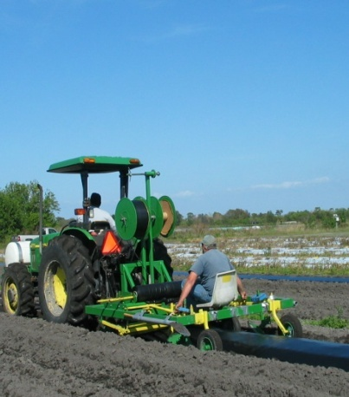
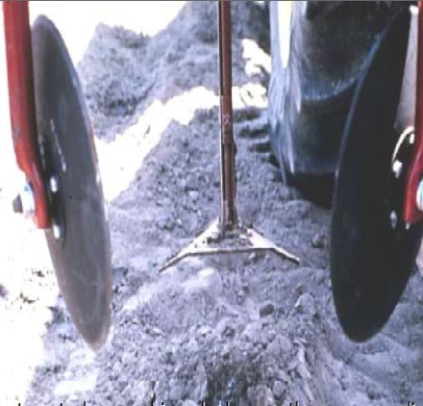
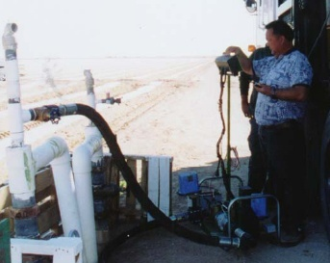
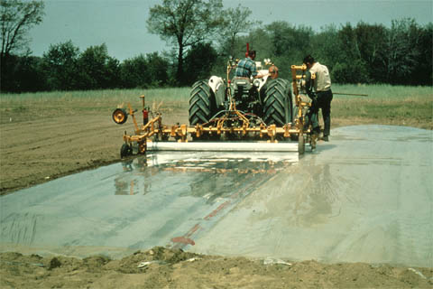
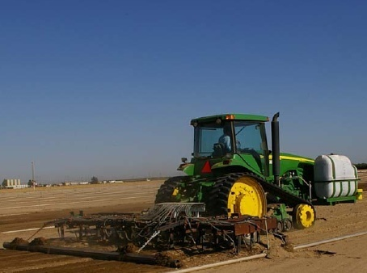
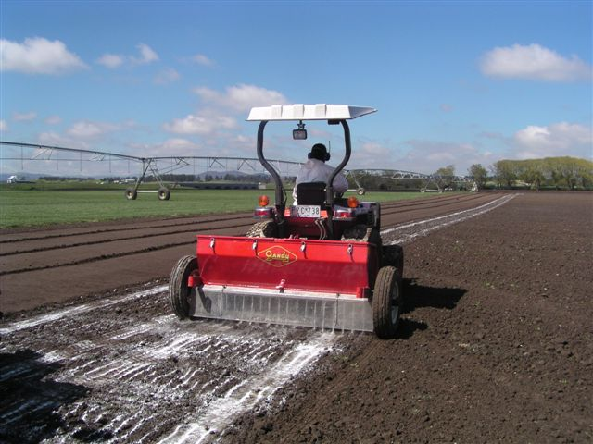
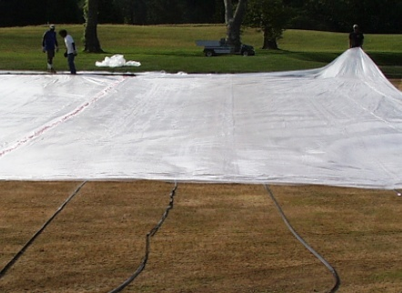
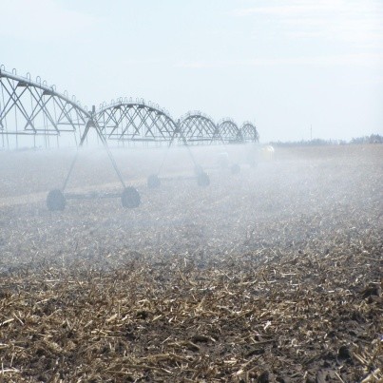
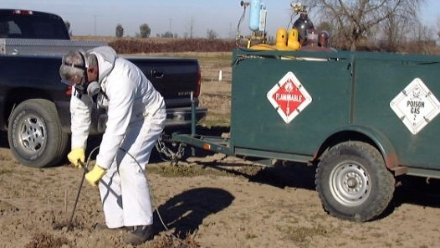
Application Methods
Shank bedded
Spray blade
Shank
broadcast
Drip irrigation
Rotor tiller
shank
no tarp
Center
pivot
Tree hole
5
Hot gas
Notes:
5
Here are the main application methods that are used for MeBr, Pic, metam, and dazomet.
In the Midwest, the most prevalent chemical and method used is metam sodium applied with a center pivot.
In the Southeast, a tarped bedded shank application is the most prevelant. Bedded applications are common in the Northwest, but without tarps.
One exception to that, however, is in the Pacific Northwest, where methyl bromide is applied using the shank broadcast method.
EPA’s risk assessments included all of these application scenarios.

Slide 6
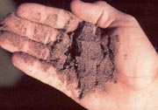
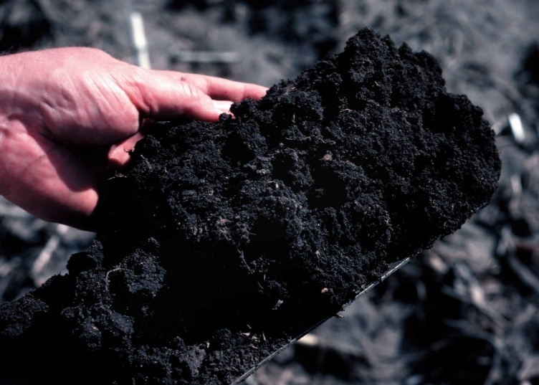
Examples of Generic GAPs
Soil moisture
  Appropriate for soil type
  Determined using USDA’s Feel and Appearance method or an instrument
Soil preparation
  good tilth
  free of large clods
  crop residue
  (if present) must not interfere with soil seal
Photos courtesy of USDA NRCS
Notes:
Here are 2 examples of generic good agricultural practices.
While the label on different fumigants may have different language regarding these requirements, the general concepts are the same and the GAPs are equally important when using any of the fumigants.
The fumigant will be more effective at controlling pests, and will remain in the soil for a longer period of time, if the soil has the proper amount of moisture at the time of the application.
For chloropicrin and methyl bromide the soil must be moist 9 inches below the surface; and for metam the soil must be moist in the top 6 inches. To determine if there is sufficient moisture in the soil, fumigant users can either utilize the USDA Feel and Appearance Method or an instrument, such as a tensiometer. If there is insufficient moisture, the user has to adjust the soil moisture by irrigation, discing or plowing.
The user must document in the Fumigant Management Plan the state of the soil moisture before application.
Here is another example of a Good Agricultural Practice that is generic:
Proper soil preparation ensures that applications are more effective at controlling pests and helps seal fumigants in the soil.
The user must prepare the soil to the depth of the treatment zone.
Large clods should be broken down as much as possible
While EPA understands that “Large” is subjective, we wanted to provide the flexibility that growers need:
- in all parts of the country,
- to make applications to different soil types,
- and to use different application methods.
Soil conditions and the steps taken to ensure proper soil preparation were achieved prior to the application will be documented on the FMP.

Slide 7
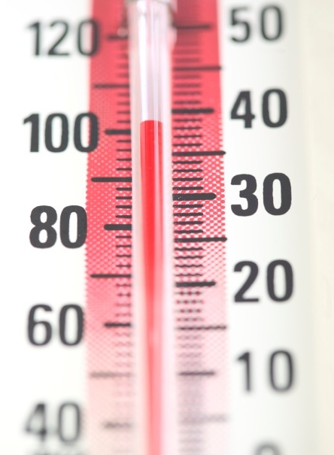
Another Example of a Generic GAP
Soil temperature
Maximum soil temperature is 90 degrees F
Depth of soil temperature measurement varies
Notes:
Another example of a generic GAP is soil temperature.
Similar to the Good Agricultural Practice on soil moisture, achieving the proper soil temperature helps make applications more effective at controlling pests while, at the same time, preventing fumigants from moving quickly out of the soil. For some fumigants, e.g., metam, lower soil temperatures are generally more conducive to keeping the product in the soil.
Soil fumigant applications (except drip) will require a maximum soil temperature of 90 degrees Fahrenheit. The pesticide user must measure and record the soil temperature in the Fumigant Management Plan (FMP) under certain conditions, for example, the soil temperature must be measured if the air temperature was over 100 degrees Fahrenheit in any of the 3 days prior to the application.
There may be different depth requirements for taking soil temperatures, depending on the method of application used.
For example, for a ground rig application of metam, the user must measure the soil temperature at the depth of injection. For metam chemigation applications, the soil temperature must be measured at a depth of 3 inches. Even though chemigation applications are made to the soil surface, they are intended to penetrate 3-10 inches deep into the soil.
Explanation of the drip exception:
Once water is applied, the soil cools through evaporation. Nonetheless, some of the labels will require a specific soil temperature for drip applications.

Slide 8
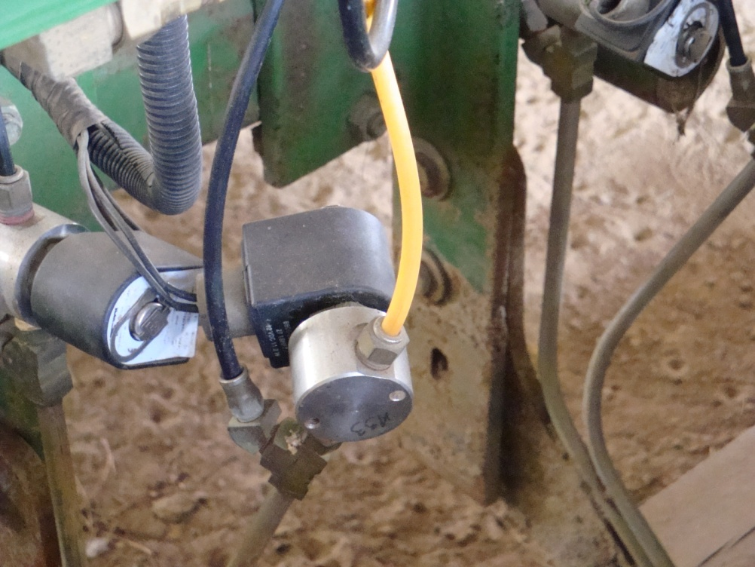
Other GAPs
Soil seal
Calibrate, maintain, and clean equipment
Prevent end-row spillage
Module 4: Good Agricultural Practices
Notes:
Some examples of other Good Agricultural Practices are:
Sealing the soil;
Calibrating the application equipment;
And
Preventing end-row spillage.

Slide 9
Protections for
Handlers & Workers
(2010)
Notes:
EPA’s risk assessments, which were based on the best available information including
human and animal toxicity studies,
exposures based on monitoring and modeling data, and
incidents
indicate that there are risks to handlers and workers that are of concern. This module covers the new requirements that will be on labels to address these risks.

Slide 10
Restricted Use Pesticide Classification
Before reregistration:
-Restricted use:
    methyl bromide
    1,3-dichloropropene
    chloropicrin
  -Non-restricted use products
    (most) metam sodium/potassium
    (most) dazomet
After reregistration: ALL are restricted use
10
Module 5: Protections for Handlers & Workers
Notes:
10
The first measure to address applicator and worker safety is the Restricted Use Pesticide (RUP) classification.
When EPA began the Reregistration Eligibility Decision (RED) process, some soil fumigant products were already restricted use pesticides, e.g., methyl bromide, 1,3-dichloropropene, chloropicrin, and some metam products.
However, most of the metam sodium/potassium and dazomet soil use products were NOT classified as restricted use pesticides
Now ALL of the soil fumigant products will be restricted use.
All products meet the criteria for restricted use.
Although metam sodium/potassium and dazomet do not trigger the toxicity requirements for Restricted Use (RU), MITC (METHYL ISOTHIOCYANTE), the breakdown product of metam sodium/potassium and dazomet, does.
Therefore, the soil uses of metam sodium/potassium and dazomet will be reclassified as restricted use.

Slide 11
Who is a “handler”?
A person in: | from start of application | to end of:
1. application block |  | entry restricted period
2. buffer zone |  | buffer zone period
Module 5: Protections for Handlers & Workers
Notes:
Now we will focus on handler mitigation.
In meetings with applicators, growers, and other stakeholders, EPA heard a lot of different opinions regarding what a “handler” was and what tasks were performed by “handlers” versus “Re-entry workers”.
EPA decided to reduce confusion by listing all handler activities on labels so that it would be clear who would have to receive the appropriate training, information, and Personal Protective Equipment.
For fumigation applications a person performing a handler task is considered a “handler”:
if they are in the application block at any point from when the application begins until the entry restricted period ends, and/or
if they are in the buffer zone at any point from when the application begins until the buffer zone period ends. (Buffer zone restrictions will be on labels in 2011.)
The only exception for this would be for someone in transit through the buffer zone.
Handler tasks are listed on the next slide.
DEFINITIONS
Application block: the area within the perimeter of the field where the fumigant is applied, the perimeter of the application block is the border that connects the outermost edges of the total area treated with the fumigant product within any 24-hour period (except for center pivot chemigation that occurs over several days).
Buffer zone: area around the application block where bystanders must be excluded during the buffer zone period, except for people in transit.

Slide 12
Supervision of Handlers
Non-water run applications (e.g., shank, hot gas)
“Certified applicators must be at the fumigation site in the line of sight of the application and must directly supervise all persons performing handling activities”
Water run applications (e.g., center pivot, drip)
Certified applicator must be at site to begin the application
Certified applicator or handlers under supervision of certified applicator must return every two hours to check on application
Handlers communicate with certified applicator via cell phone or other means
12
Module 5: Protections for Handlers & Workers
Notes:
12
This slide discusses handler supervision.
New labels will contain different requirements for water and non-water run applications.
For non-water run applications (for example, a shank application): the applicator must be at the fumigation site and in the line of sight of the application and handlers;
For water run applications (for example, a center pivot or drip application): the applicator can leave after starting the application but then must check back every two hours.
Alternatively, handlers under the supervision of the certified applicator could check back every 2 hours, as long as they can communicate with the certified applicator via cell phone or other means.

Slide 13
Handlers Example
Must Wear Proper PPE:
Example Metam CLR Label:
Page 2: chemigation
Long-sleeve shirt and long pants
Shoes plus socks
Protective eyewear
AND you now determine who wears an APR
13
Notes:
13
This slide is an example for handlers.

Slide 14
Respiratory Protection for Handlers
If experiencing sensory irritation, handlers must either:
Stop work, leave area & monitor air concentrations
  Resume work only when concentrations are below trigger level & irritation is gone
OR
Wear a respirator & resume work
    -Measure air concentration every 2 hours
    -Stop work if having sensory irritation while wearing respirator, or measured concentration exceeds upper working limit of respirator
  If still having sensory irritation, can resume work only when concentrations are below trigger level, irritation is gone, and have changed respirator cartridge
  Note: air purifying respirators are required for methyl bromide products with less than 20% chloropicrin
14
Module 5: Protections for Handlers & Workers
Notes:
14
This next section of slides discusses the respiratory protection requirements for handlers.
Until recently, labels required handlers to use respirators if the air concentration action level was exceeded, but the labels did not require air monitoring.
Labels will now require handlers to either stop work or put on a respirator if sensory irritation is experienced.
If applicators decide to stop work, rather than wear a respirator, then handlers must leave the area (the “area” referred to here is the application block and/or the buffer zone) and handlers cannot return to work until monitored air concentrations are below the trigger level stated on the label, and the handler must not feel any more irritation.
Although this approach is not described on older labels, many applicators have said that they already use these practices. They prefer it over having to wear a respirator all of the time.
One exception is for methyl bromide products with less than 20% chloropicrin.
Based on the available data, EPA believes that there is not enough chloropicrin in the formulation to serve as an adequate warning agent.
Therefore, half-mask respirators are required for all handling activities when using these products
If a handler experiences sensory irritation and decides to put a respirator on instead of stopping work, then every 2 hours the air concentration must be measured using a direct-read detection device. Air sampling must be performed to ensure that the maximum use concentration for the respirator and/or filter cartridge is not exceeded (5 ppm for MeBr, 1.5 ppm for pic, and 600 ppb for MITC)
If handlers still experience sensory irritation while wearing the respirator, they must stop working, leave the area, and they cannot resume working until
1. Air monitoring shows that concentrations are below the trigger level on the label,
2. They no longer experience any sensory irritation, and
3. They have changed the respirator cartridge.
The applicator must record in the post application summary: the date and time that sensory irritation was experienced, the handler activities involved, whether operations ceased or respirators were used, and results of air monitoring.

Slide 15
Figure A. Requirements when handlers cease operations
Handler activity begins.
Handlers are NOT wearing APRs.
Sensory Irritation
Certified applicator in charge decides to cease operations rather than continue with respirators.
Handlers must stop work and leave application block and buffer zone.
If 2 samples taken at least 15 minutes apart show concentrations are less than the label action level and nobody has sensory irritation, then
Resume operations.
Module 5: Protections for Handlers & Workers
Notes:
15
This diagram depicts the requirements discussed on the previous slide if the applicator decides to cease operations after handlers experience sensory irritation.
(NOTE: APR = air purifying respirators)

Slide 16
Figure B. Requirements when handlers resume work while using a respirator
Handler activity begins. Handlers are NOT wearing APRs.
Sensory Irritation
Certified applicator in charge decides to resume operations.
All handlers in the application block and buffer zone put on an APR. Air monitoring program begins.
Feel irritation through APR, OR monitoring indicates concentrations above max use concentration (MUC) for APR
Handlers must stop work and leave application block and buffer zone.
If 2 consecutive samples taken at least 15 minutes apart, by a handler wearing an APR, are less than the label trigger level and NO sensory irritation, then
If, 2 consecutive samples taken at least 15 mins apart, by a handler wearing an APR are above the label trigger level BUT less than the MUC, no sensory irritation is felt, and the cartridge is changed, then
Resume operations without an APR or remove respirator.
Resume operations wearing an APR.
Air monitoring continues.
16
Notes:
16
This diagram shows what the label requires when applicators decide to continue working with respirators after handlers experience sensory irritation.
(NOTE: APR = air purifying respirator)
(NOTE: definition of a Maximum use concentration from OSHA 29 CFR Part 1910 -
Maximum use concentration (MUC) means the maximum atmospheric concentration of a hazardous substance from which an employee can be expected to be protected when wearing a respirator, and is determined by the assigned protection factor of the respirator or class of respirators and the exposure limit of the hazardous substance.)

Slide 17
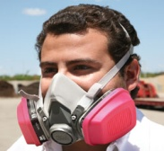
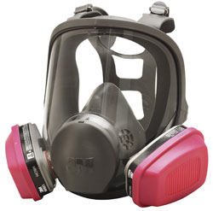
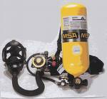
Number of Handlers and Respirators
Required On-site During Handler Activities
Module 5: Protections for Handlers & Workers
Notes:
17
Now that I have covered when respiratory protection is required, this slide covers the minimum number of handlers and respirators that are required to be on-site for each of the fumigants.
For handling tasks with methyl bromide, chloropicrin only, and other products with chloropicrin, there must be on-site a minimum of:
2 handlers, 2 air purifying respirators, and 1 Self-contained breathing apparatus.
Metam sodium/potassium and dazomet require that 1 handlers is on-site, and there is no requirement to have a Self-Contained Breathing Apparatus on-site.
Regardless of the requirements, for every fumigant all of the equipment must be on site and available for use
For formulations that contain at least 20% chloropicrin, and for metam sodium/potassium and dazomet products, if handler experience sensory irritation or if the air concentrations hit the label action levels, a full face Air purifying respirator is required
For methyl bromide products with less than 20% chloropicrin, a half mask Air Purifying Respirator is always required
(when Air Purifying Respirators are worn, air monitoring is required by the label to ensure that the maximum used concentration of the APR is not exceeded)

Slide 18

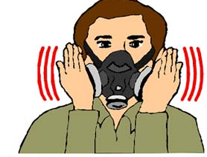
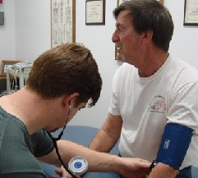
Handlers who use respirators must be:
fit-tested
trained
physically fit to wear a respirator*
Module 5: Protections for Handlers & Workers
* http://www.osha.gov/pls/oshaweb/owadisp.show_document?p_table=STANDARDS&p_id=9783
18
Notes:
18
All handlers who wear a respirator must be fit tested, trained on how to use the respirator, and medically qualified to wear a respirator.
Fit testing and training must be done with a program that conforms to OSHA’s requirements (29 CFR 1910.134).
Also, handlers must fill out a medical questionnaire, and depending on their answers to the questionnaire, a medical practitioner may determine that the handler has to have a physical exam. (For example, if the handler has a heart condition.)
If you go to the link at bottom of this slide, you can see the questions on the questionnaire.
If Questions: additional information on fit-testing:
There are two general types of tests that are used to ensure respirators fit the users -- Qualitative (QLFT) and Quantitative (QNFT) fit tests
The Qualitative Fit Test is a pass/fail fit test. The correct respirator fit is determined using the individual's response to the test agent.
The Quantitative Fit Test determines the fit by numerically measuring the amount of leakage into the respirator.
Most Half-mask Air Purifying Respirators, Full-face Air Purifying Respirators, and Self-Contained Breathing Apparatuses may be fit-tested to the handler using a Quantitative Fit Test or a Qualitative Fit Test.
There are Self-Contained Breathing Apparatuses that operate in the demand mode.
OSHA defines a “Demand respirator” as an atmosphere-supplying respirator that admits breathing air to the facepiece only when a negative pressure is created inside the facepiece by inhalation. (can be found in 29 CFR Part 1910)
A self-contained breathing apparatus that operates in the demand mode must be fitted to the handler using a Quantitative Fit Test; however, these respirators are not likely to be used by pesticide handlers.

Slide 19
Handlers who use respirators must be:
fit-tested
trained
physically fit to wear a respirator*
For Pic mixtures: at least 2 air purifying respirators and 1 SCBA on site when handling actives performed
For metam: at least 1 air purifying respirator on site when handling activities are performed
Module 5: Protections for Handlers & Workers
* http://www.osha.gov/pls/oshaweb/owadisp.show_document?p_table=STANDARDS&p_id=9783
19
Notes:
19
All handlers who wear a respirator must be fit tested, trained on how to use the respirator, and medically qualified to wear a respirator.
Fit testing and training must be done with a program that conforms to OSHA’s requirements (29 CFR 1910.134).
Also, handlers must fill out a medical questionnaire, and depending on their answers to the questionnaire, a medical practitioner may determine that the handler has to have a physical exam. (For example, if the handler has a heart condition.)
If you go to the link at bottom of this slide, you can see the questions on the questionnaire.
If Questions: additional information on fit-testing:
There are two general types of tests that are used to ensure respirators fit the users -- Qualitative (QLFT) and Quantitative (QNFT) fit tests
The Qualitative Fit Test is a pass/fail fit test. The correct respirator fit is determined using the individual's response to the test agent.
The Quantitative Fit Test determines the fit by numerically measuring the amount of leakage into the respirator.
Most Half-mask Air Purifying Respirators, Full-face Air Purifying Respirators, and Self-Contained Breathing Apparatuses may be fit-tested to the handler using a Quantitative Fit Test or a Qualitative Fit Test.
There are Self-Contained Breathing Apparatuses that operate in the demand mode.
OSHA defines a “Demand respirator” as an atmosphere-supplying respirator that admits breathing air to the facepiece only when a negative pressure is created inside the facepiece by inhalation. (can be found in 29 CFR Part 1910)
A self-contained breathing apparatus that operates in the demand mode must be fitted to the handler using a Quantitative Fit Test; however, these respirators are not likely to be used by pesticide handlers.

Slide 20
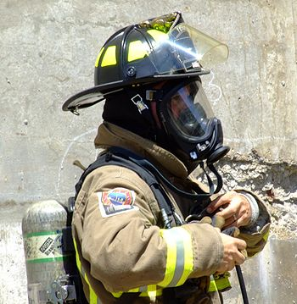
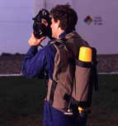
A self contained breathing apparatus, or SCBA, sometimes referred to as a Compressed Air Breathing Apparatus (CABA), air pack, or simply Breathing Apparatus (BA) is a device worn by rescue workers, firefighters, and others to provide breathable air if the max use concentration for the APR is exceeded, the air concnetration is unknow, or there is ann an IDLH (Immediate Danger to Life and Health) Atmosphere.
An SCBA typically has three main components: a high-pressure tank (e.g., 2200 psi to 4500 psi), a pressure regulator, and an inhalation connection (mouthpiece, mouth mask or face mask), connected together and mounted to a carrying frame.
National Institute for Occupational Safety and Health

Slide 21
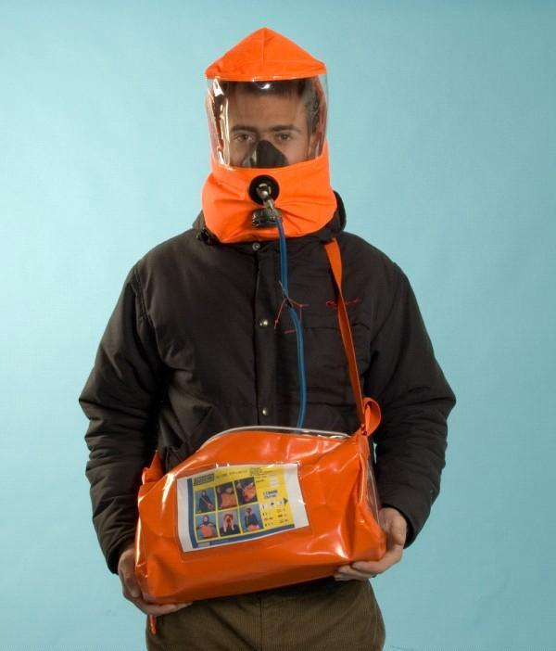
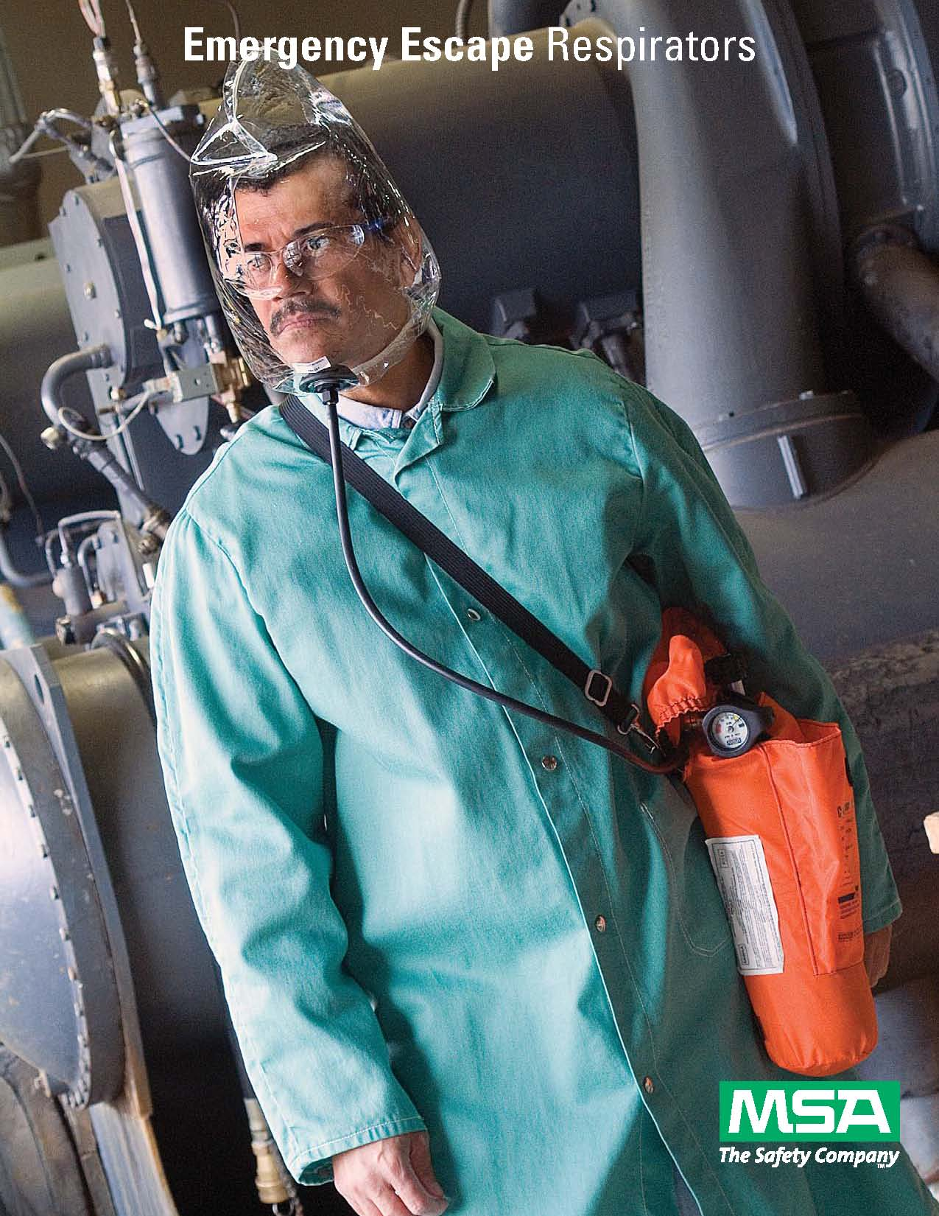
Emergency Escape Breathing Apparatus – are for escape only and Not Approved for responding to spills or other emergencies

Slide 22
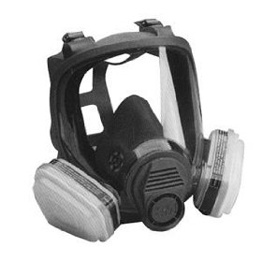
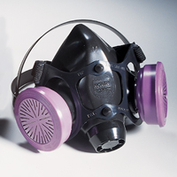
Respirators – must be fit tested and use the appropriate cartridges for the fumigant product being used.
Half Faced Respirators
Full Faced Respirators
Fit Tested
No Facial hair that interferes with skin and face-piece seal

Slide 23
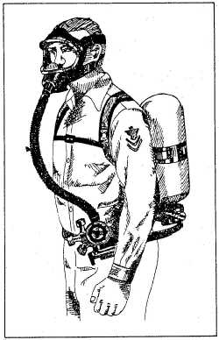
RESPIRATOR FIT TESTING
The OSHA Standard 1910.134 (1998) requires fit testing of all respirators including those with positive pressure. The respirator fit test is done to check that the mask size and mask model chosen fits the face. The fit test confirms that the mask fits the wearer's face and that there is minimal air leakage between the face and the mask.
A respirator medical evaluation (questionnaire) conducted within the last 12 months by a qualified Licensed Healthcare Practitioner (LHP) or physician.

Slide 24
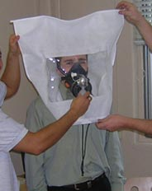
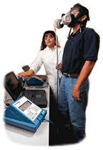
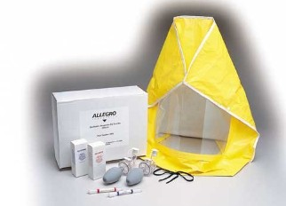
TWO TYPES OF FIT TESTING
Qualitative fit testing is adequate and will comply with all APRs and most SCBAs (some SCBAs used for fire fighting may require quantitative fit test but these will not likely be used by applicators). Sample of total costs for having a company come to do fit tests and medical questionnaires are as follows: for <10 workers: $100 per worker, 11-20 workers: $78 per worker, 21-30 workers: $58 per worker (see http://bestfittest.com/ ). Companies may be willing to negotiate competitive prices.
Quantitative fit testing gives an objective measure of the quality of the seal between the wearer's face and the facepiece. A fit factor number is produced.
Cost:$8200 Rental:$600.00
Supplies: $125/24 test
Respirator Adapter: $125 - 275
Growers can do their own fit testing as long as they conduct once a year and document using an approved test.

Slide 25
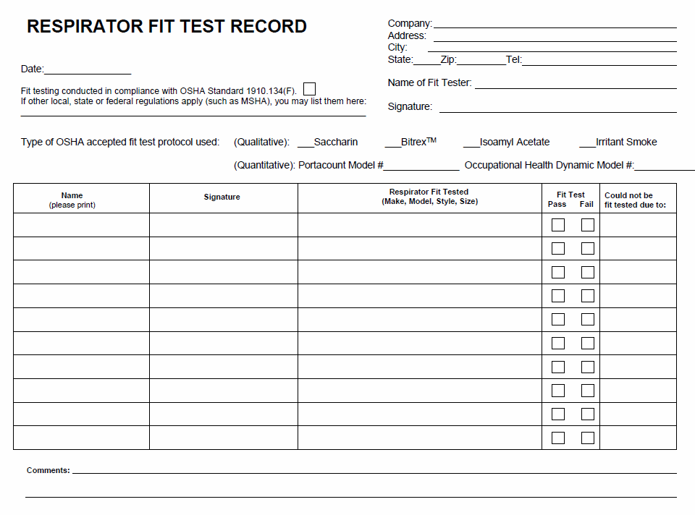

Slide 26
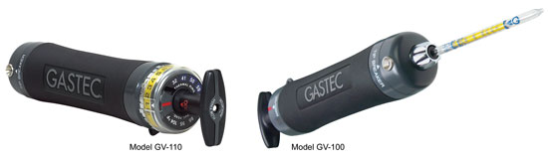
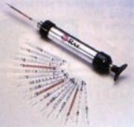
GAS DETECTION
Detector tube Pump - $340.00 - $400.00
Gas Detection tubes - $12.00/sampling tube
Chemical | Gas
Metam Sodium | methyl isothiocyanate
Chlorpicrin | chlorpicrin
PALADIN | dimethyl disulfide
Telone II | 1,3-dichloropropen
MIDAS | methyl iodide
Methyl Bromide | methyl bromide

Slide 27
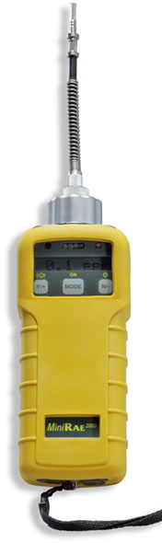
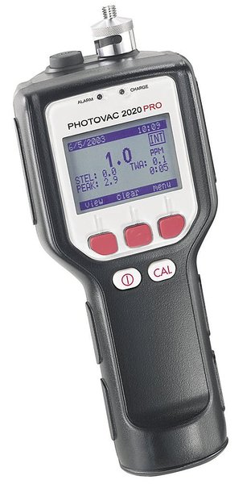
Handheld volatile organic compound (VOC) detector
Its uses Photoionization Detector (PID)
MiniRAE 2000
Chemical | Gas
Metam Sodium | methyl isothiocyanate
Chlorpicrin | chlorpicrin
PALADIN | dimethyl disulfide
Telone II | 1,3-dichloropropen
MIDAS | methyl iodide
Methyl Bromide | methyl bromide
PHOTOVAC
$3,500- 5,000

Slide 28
Tarp Perforation & Removal
Perforation
5 days after fumigant application is complete
Removal
2 hours after perforation is complete
Module 5: Protections for Handlers & Workers
Notes:
This section of the module focuses on new tarp perforation and removal requirements. These requirements are based on risk concerns that handlers are being exposed to high concentrations when they are perforating and removing tarps. And while not all soil fumigant applications involve the use of tarps, for the applications that use tarps there are some new requirements.
New labels will require that tarps remain on the field for at least 5 days after the application is complete – whereas “old” labels allow tarps to be perforated and removed 48 hours after the application is complete.
In addition to the new tarp perforation requirement, tarp removal cannot begin until at least 2 hours after tarp perforation is complete. This is to ensure that any remaining fumigant dissipates before tarps are removed.
If tarps are not removed after perforation, planting can occur either
48 hours after perforation is complete, or
If tarps are perforated more than 14 days after the application, planting can occur at the same time tarps are perforated.

Slide 29
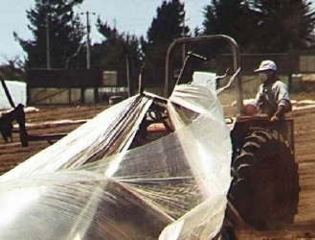
Tarp Perforation Requirements - Broadcast Applications
Must perforate each panel of tarp (mechanically) two hours before removal
Complete before noon
Cannot perforate if
rainfall is expected
within 12 hours
Module 5: Protections for Handlers & Workers
Notes:
For broadcast applications, there are additional specific perforation requirements.
Each tarp panel must be perforated.
Perforation must be completed before noon, and
Tarps must not be perforated if rainfall is expected within 12 hours
Both of these last two requirements are on labels to address the potential of fumigants reaching the groundwater.
If Questions:
When the temperature lowers in the late afternoon and evening, the fumigant that remains under the perforated tarp cannot dissipate as well, and rainfall may cause it to leach into ground water. For raised bed applications, rainfall is not a factor since planting occurs with the tarp in place and perforation and/or tarp removal occurs after the fumigant has dissipated.
Additional notes:
Some commenters suggested that every 1-3 tarp panels should be cut based on the professional judgment of the handler.
The Agency believes cutting every panel allows the fumigant trapped beneath each panel to off-gas before the tarp is removed. If each panel is not cut, it is unlikely that off-gassing can happen, which is necessary before handlers remove the tarps. The Agency understands that the main concern for not cutting every panel is that there is a potential for tarps to blow off. Therefore, EPA shortened the period of time that handlers have to wait between perforation and removal from 24 hrs to 2 hrs.

Slide 30
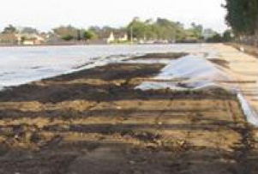
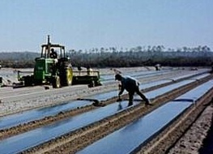
Early Tarp Perforation & Removal
Early removal (before 5 days) for broadcast applications
Only if integrity of tarp is compromised by adverse weather conditions & tarp poses a safety hazard
Early perforation - flood prevention activities
Module 5: Protections for Handlers & Workers
Notes:
This slide covers some exceptions to the perforation and removal requirements for two particular situations:
for early removal of tarps used in broadcast applications if a weather condition exists, such as high wind, hail and storms, that may compromise the integrity of the tarp and the tarp poses a safety hazard, and
(2) for early perforation of tarps for flood prevention activities. In this situation, the tarp must be retucked and packed after the soil is removed.
Both exceptions were included based on comments from growers and applicators.

Slide 31
Entry Restricted Period by Scenario
If application is… | and tarp is… | ______ days after application is completed |  | workers may enter…
1. Untarped | - | - | 5 days after application is complete
2. Tarped | Perforated & Removed | within 14 days | after tarp is removed
3. Tarped | Perforated BUT Not Removed | within 14 days | 48 hours after perforating tarps
4. Tarped | Perforated and/or Removed | more than 14 days | 5 days after application is complete
Notes:
This slide provides a quick overview of the 4 scenarios.
The main things to keep in mind when figuring out the entry restricted period are
Is the application tarped?
If yes, when will tarps be perforated and removed?
(Go through each scenario on the slide)

Slide 32


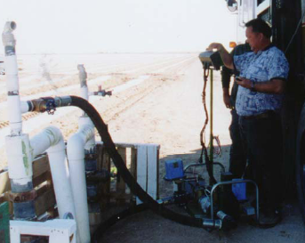
Scenario 1 - Entry Restricted Period for Untarped Applications
5 days after application is complete
Drip Untarped
Shank Untarped
Center Pivot
32
Notes:
In this slide, and in the next group of slides, I will go over different examples of entry restricted periods for untarped and tarped application scenarios.
As I mentioned, the entry restricted period varies depending on the application method
For untarped applications, the entry restricted period is in effect until 5 days after the application is complete. This means that during the application and the 5 days after the application, properly equipped handlers trained per the Worker Protection Standard can enter the application block. However other workers are prohibited from entering the application block during this time.
On the label, it would say:
Entry (including early entry that would otherwise be permitted under the WPS) by any person—other than a correctly trained and PPE-equipped handler who is performing a handling task—is prohibited from the start of the application until:
• 5 days (120 hours) after application has ended for untarped applications,

Slide 33
Scenario 2 - Entry Restricted Period for Tarped Applications
If tarps are perforated & removed less than 14 days…
Enter after tarp is removed
Module 5: Protections for Handlers & Workers
Notes:
Now let’s move onto Scenario 2. As previously mentioned, for tarped applications, the entry restricted period varies based on when tarps are perforated and removed.
For example, if tarps are both perforated and removed less than 14 days after the application is complete, other workers are prohibited from entering the treated area until tarp removal is complete.
This is common for tarped broadcast applications.
On the label, it will say:
Entry (including early entry that would otherwise be permitted under the WPS) by any person—other than a correctly trained and PPE-equipped handler who is performing a handling task—is prohibited from the start of the application until:
• After tarps are perforated and removed if tarp removal is completed less than 14 days after application

Slide 34
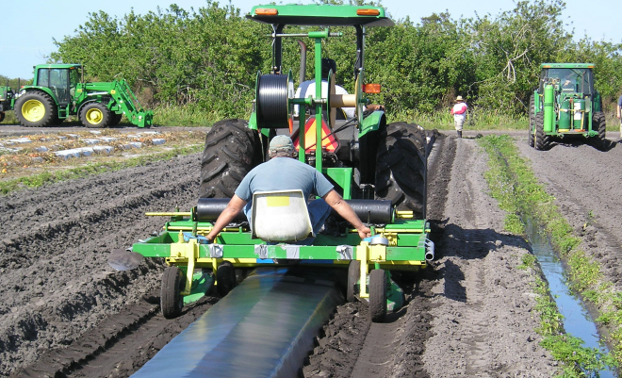
Scenario 3 - (Not ideal, may lose efficacy) Entry Restricted Period for Tarped Applications
When tarps remain on field at least 14 days, but poke hole between days 5 and 14 …
Enter 48 hours after perforating tarps
Module 5: Protections for Handlers & Workers
Notes:
This slide depicts the third entry restricted period scenario.
In this case, if tarps are perforated before 14 days after the application ends, and the tarps are not removed for at least 14 days after the application, other workers are prohibited from entering the application block for 48 hours after the tarps are perforated.
This would be common for tarped bedded applications where the grower wants to plant as early as possible.
The label would say:
Entry (including early entry that would otherwise be permitted under the Worker Protection Standard) by any person—other than a correctly trained and PPE-equipped handler who is performing a handling task—is prohibited from the start of the application until:
48 hours after tarp perforation is complete if tarps will not be removed for at least 14 days following the application

Slide 35
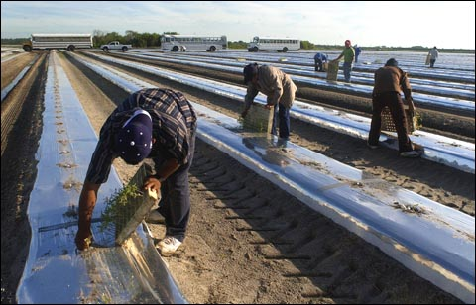
Scenario 4 (Ideal) - Entry Restricted Period for Tarped Applications
  When tarps remain on field at least 14 days and are not perforated for 14 days or more…
  Enter after 5 days
Module 5: Protections
for Handlers & Workers
Notes:
Now we will go over the last scenario.
In this case, if tarps are perforated and removed at least 14 days after the application, other workers are prohibited from entering the application block for 5 days after the application.
This is common for tarped bedded application where there is no rush to plant, and perforation and planting happen at the same time.
The label would say:
Entry (including early entry that would otherwise be permitted under the WPS) by any person—other than a correctly trained and PPE-equipped handler who is performing a handling task—is prohibited from the start of the application until:
5 days (120 hours) after the application is complete and tarps are not perforated and removed until 14 days after the application is complete.

Slide 36
Summary
All soil fumigants will be restricted use
“Handlers” is defined – and activities listed on label
Handlers must stop work or wear a respirator if experiencing sensory irritation
Tarps must remain on treated fields for 5 days after application, with some exceptions
Only protected handlers can enter the application block during the entry restricted period
Entry restricted period varies by application scenario
Module 5: Protections for Handlers & Workers

Slide 37
Fumigant Management Plans and
Post Application Summary Reports
Notes:
In this module, we will go over the requirements for Fumigant Management Plans and Post Application Summary Reports.

Slide 38
What is a
Fumigant Management Plan (FMP)?
A written, site-specific plan prepared before fumigation begins
Plan all aspects of a safe and effective fumigation to help:
  Prevent accidents
  Ensure, demonstrate & verify compliance
  Define procedures in case of accidents or unforeseen events
38
38
Module 6: FMPs
Notes:
38
38
Fumigation is a complex activity that is specific to each site, and many fumigant labels are long, with detailed directions and requirements for safe and effective use.
Nonetheless, failure to follow label requirements as well as procedures for safe use, has contributed to incidents that affected handlers, workers, and bystanders.
Information from incidents and complaints shows that exposures have often resulted from:
Applicators not following label directions;
A lack of safety planning before applying the fumigant; and
Uncertainty on how to respond to a problem.
Studies have shown that, in general, written plans for carrying out complex procedures help reduce workplace accidents and injuries. As a result, such plans have become a common tenant of industrial hygiene practices.
Several commercial applicators, who use a large volume of soil fumigants, already use written plans to make safe and effective applications, and to have an appropriate response ready in case of an accident or emergency.
Fumigant product labels will require that applicators complete a site-specific written Fumigant Management Plan before making an application.
The plans will help both applicators and inspectors by guiding applicators through label directions, and by helping inspectors determine that applicators are in compliance with the product label.

Slide 39
FMPs – Who?
Completed by grower, commercial applicator, crop consultant, or others
Certified applicator in charge:
  Verifies accuracy
  Signs
May be farm-wide
  Common information in one place
  Separate sections for information unique to each fumigant application
Must be available to handlers, enforcement personnel, and emergency response personnel
Module 6: FMPs
Notes:
39
Anyone may develop the FMP, but the certified applicator in charge of the application must, before beginning the fumigation, review, sign and date it to verify that it is accurate, up-to-date and complies with the label.
Note that FMPs do not require anything independent of the label– they only capture how the applicator is complying with label requirements and serve as a record of how they complied.
Growers have the option of developing a farm-wide FMP. In this case, the information that is common to all application blocks on the operation would be documented in one place, for example, in the first section of a binder. This might include information about the applicator, owner/operator, the handlers, emergency response plans, and maybe information on the product, tarps, and application method.
Then the information that is unique to each separate application block would be captured in different sections. This would include the location and size of each application block, buffer sizes, application dates, weather and soil conditions.
Farm-Wide FMPs are optional and may be helpful to those who operate multiple fields that are treated as separate application blocks.
Last, but not least, FMPs must be kept on site and made available:
For viewing by handlers involved in the fumigation;
To enforcement personnel upon request, and
Emergency responders in case of an emergency.
39

Slide 40
Record Keeping
Keep FMPs and Post Application Summaries for 2 years
  supervising certified applicator
  owner/operator (if not the certified applicator)
Keep with other records required for application of RUPs
40
Module 6: FMPs & Post Application Summary
Notes:
40
The supervising certified applicator and the owner/operator, if he or she is not the certified applicator, must keep a copy of the Fumigant Management Plan and the post application summary report for two years. This is in sync with the requirement that records be kept for two years on applications of Restricted Use Pesticides --although some states require that records be kept for more than 2 years.
EPA believes that both the Fumigant Management Plan and Post Application Summary will be helpful to inspectors– along with their other resources, such as use inspection checklists, records, and observations on site, because they will help inspectors get a clearer picture of whether and how an applicator complied with the labeling.
(NOTE: a question may come up about whether an information collection request (ICR) is required for Fumigant Management Plans and Post Application Summary reports; that is, does EPA need approval from OMB? The answer is yes, and OPP is developing an ICR for these requirements.)

Slide 41
FMP Templates and Tools
Adobe Acrobat templates
Microsoft Word templates
Web-based tool
Module 6: Templates and Tools
Notes:
- EPA has been working on the development of templates and tools that will make it easier to complete a Fumigant Management Plan and Post Application Summary Report and will help ensure that they have all of the information that is required to comply with the label.
EPA will make these available on its fumigant web site where anyone can go and print or download them. There are 3 main tools under development for FMPs and for the Post Application Summary Report:
1st there will be FMP templates in PDF files that can be downloaded and fill out by hand.
2nd there will also an FMP template file in a Microsoft Word fill-in-the-blank format that can be downloaded and completed using a computer.
-This template will expand each input field as the user fills in the information. It has the same content as the PDF template but since it expands as you type the actual form is much shorter.
I will show some examples of this template in the next group of slides. EPA will also post on the fumigant website a sample plan that has been filled out.
3rd, EPA is developing a web-based FMP program that similar to the Turbo-Tax software that prompts the user to input the information
- Applicators are not required to use one of EPA’s templates, but they may find them easier than developing one from scratch.
- Applicators and others are free to modify the tools that EPA has provided to meet their specific needs.

Slide 42
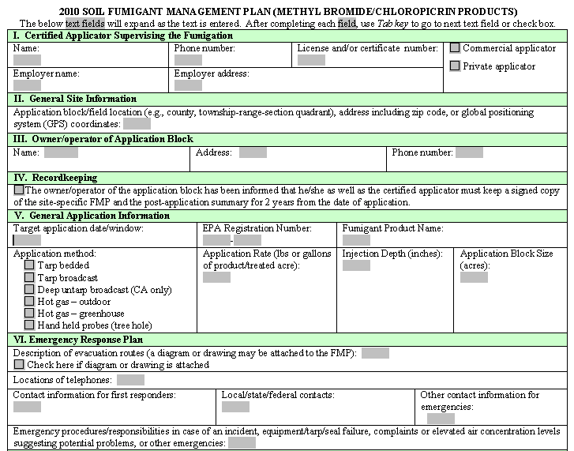
FMP Sample Template
42
42
Module 6: FMP Template
Notes:
42
42
This slide shows the MS-Word version of the FMP template that EPA developed for methyl bromide products to comply with the 2010 labels.
You can navigate through the input fields by using the tab key or clicking where you want to go.
The text blocks will expand as text is typed-in.
Much of the information can be entered by clicking a check box.
The FMP elements required by the product label that are shown here include:
-information about the certified applicator,
general site information,
information about the grower,
recordkeeping,
general application information,
and the emergency response plan

Slide 43
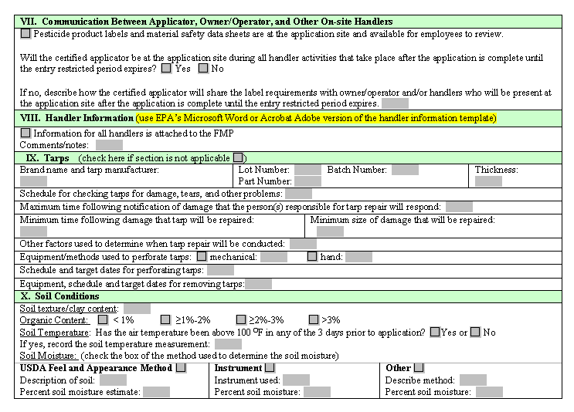
FMP Sample Template
43
43
Module 6: FMP Template
Notes:
43
43
This is a continuation of the 2010 methyl bromide template in MS Word.
The FMP elements required by the product label that are shown here include:
Communication between the applicator, grower, and other on-site handlers
Information on all of the handlers,
Tarp information, and
Soil Information
For sections that do not apply (e.g., untarped applications), a “not applicable” check box is provided and the section can be skipped.

Slide 44
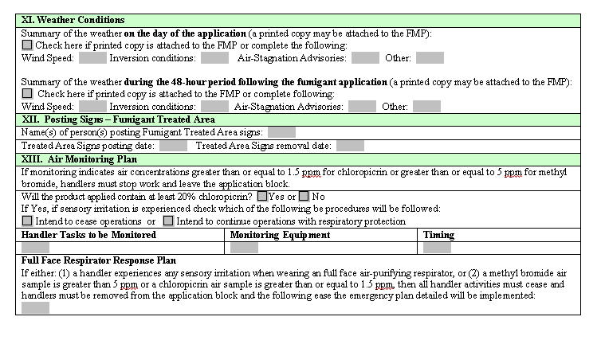
FMP Sample Template
44
44
Module 6: FMP Template
Notes:
44
44
.
The FMP elements required by the product label that are covered here include:
Weather conditions
Posting signs for the treated area, and
the Air monitoring plan
-For the weather, there is an option to attached a copy of the weather forecast

Slide 45
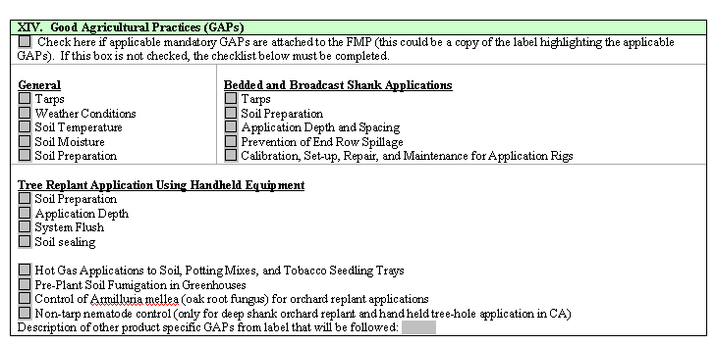
FMP Sample Template
45
45
Module 6: FMP Template
Notes:
45
45
.
This slide shows the GAP part of the template.
Applicators can attach the label highlighting applicable GAP sections or use the check boxes provided
Note that these GAPs are specific to methyl bromide products and templates for other fumigants will differ.

Slide 46
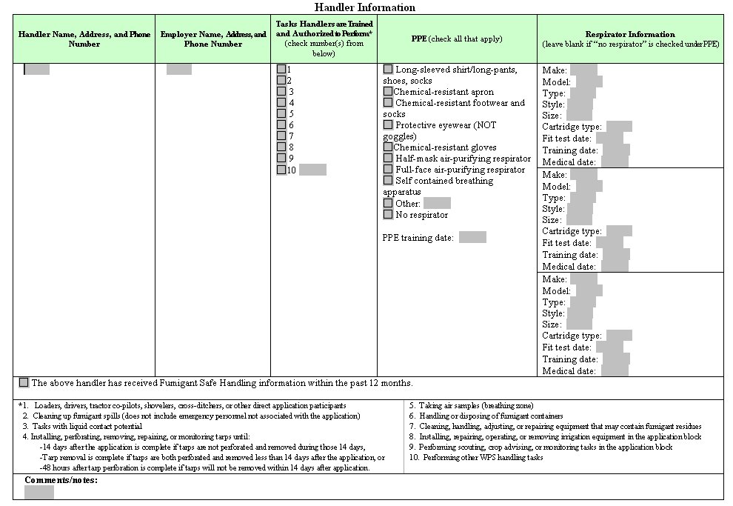
FMP Sample Template
46
46
Notes:
46
46
This part of the template is where handler information is entered.
Once it is completed for each handler, it can be printed and inserted into the site-specific FMP along with information for each of the handlers expected to be on site, as needed.
This part of the FMP will not need to be completed each time for a crew that treats multiple sites, as long as the crew includes the same handlers each time.
In situations where there is change in the handlers that actually end up working at a site, this part can be filled out for additional handlers and added to the postapplication summary

Slide 47
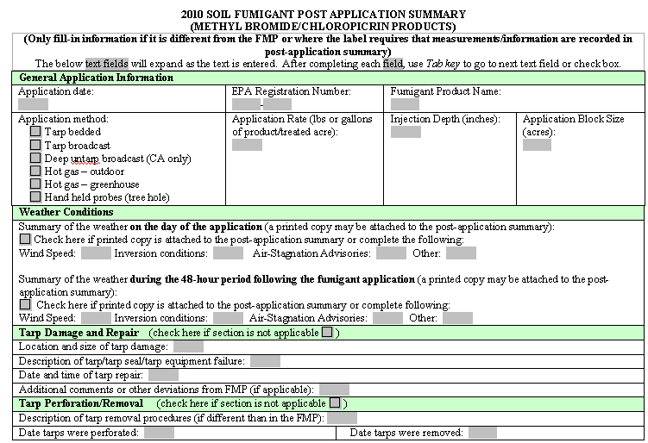
Post Application Summary Sample Template
Module 6: Post Application Template
Notes:
This is the MS Word version of the post application summary template for methyl bromide products.
Applicators are required to provide information that has changed from the FMP and where the label requires that measurements/information be recorded in the post application summary (e.g., air monitoring results)
The elements required by the product label that are covered in this section include:
general application information,
the actual weather conditions,
any tarp repair or damage that occurred, and
tarp perforation or removal, if applicable.

Slide 48
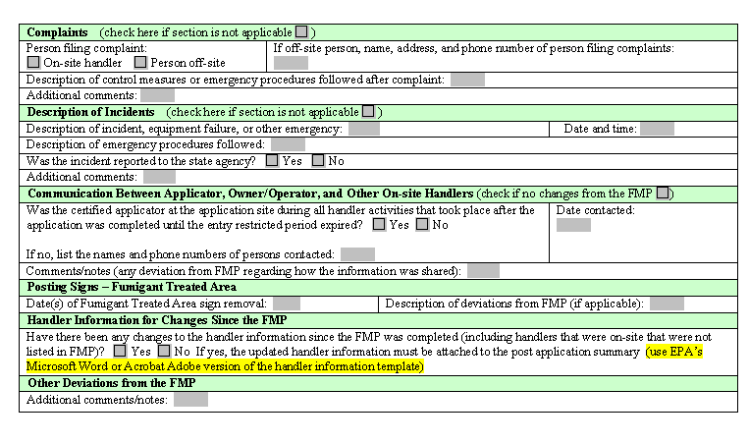
Post Application Summary Sample Template
Module 6: Post Application Template
Notes:
The elements required by the product label that are shown here include:
complaints,
description of any incidents that may have occurred,
communication between the applicator, grower, and other on-site handlers,
posting signs for the treated area,
changes to handler information (e.g., handlers not listed in FMP), and
any other deviations from the FMP.

Slide 49
Buffer Zones
Distances, Credits & Posting
(2011)
Notes:
In module 7, I will go over the requirements for buffer zones, including distances, buffer zone credits, and the posting of buffer zones.
In 2010 we have seen requirements for buffer zones appear on several pesticide labels, and for the soil fumigants 1,3,-D, dazomet, iodomethane, DMDS, and furfural
However, in 2011 it will become a requirement on ALL labels for products that have soil uses and contain methyl bromide, chloropicrin, metam sodium/potassium, and dazomet.

Slide 50
Posted Sign
Buffer zone
Roadway
Treated field
Posted Sign
50
Fence
Module 7: Buffer Zones
Notes:
50
In this example,
The Green block is the application block or treated field
The Red line is a buffer zone that extends across a roadway (left side)
Yellow dots are buffer zone signs
Signs should be posted where the BZ and Road cross (yellow dot)
The fence eliminates the need to post the right side of the field since it prevents access to the buffer
(IF ASKED: Some jurisdictions may have restrictions on putting signs along roadways. However, the REDs require applicators to comply with local laws and regulations with regard to buffers and posting.)

Slide 51
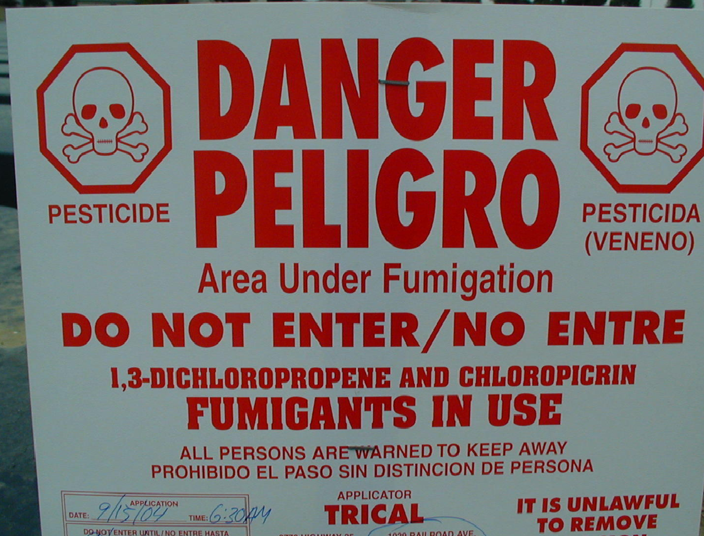
Treated Area Posting Signs
(already required on labels)
51
Module 7: Buffer Zones
Notes:
51
This is a reminder that treated area signs are already a requirement on fumigant product labels.
Here is an example of one. EPA has not changed any of the requirements for these signs.

Slide 52
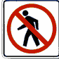
Buffer zone sign must include:
“Do Not Walk” symbol
"DO NOT ENTER/NO ENTRE,"
"[Name of fumigant, name of product] Fumigant BUFFER ZONE”
certified applicator contact information
Module 7: Buffer Zones
Notes:
52
52
This is the information that must be on a sign posted for a buffer zone.
You may notice that the content of these signs is different than the signs that are posted at the edge of a treated field.

Slide 53
Information for Handlers
(2010)
53
Module 9: Registrant Requirements
Registrants must develop and disseminate basic safety information for handlers
  Increase fumigant handlers’ safety awareness
Information:
  Safe handling practices
  Respiratory protection
  Early signs of exposure
  What to do in case of exposure or emergency
Certified applicators must make sure handlers receive information within the last year
Notes:
53
Registrants are required to develop and disseminate certain information for handlers who will be involved in fumigations.
This requirement is meant to increase the handlers’ basic awareness and understanding about safely working around fumigants.
This information will be given in addition to the training that handlers get as required by the Worker Protection Standard.
The information is related to fumigants and their use, which is not specifically covered in handler training required by the Worker Protection Standard.
Registrants are required to develop materials on: safe handling procedures, respiratory protection, signs of exposure, and what to do in case of exposure or emergency.
One requirement on labels will be that supervisors provide the information to their handlers or make sure they have received it in the last year.
The supervisor will document in the FMP that they have provided the information or that they have verified that the handlers received it within the last year.

Slide 54
Training for Certified Applicators (2011)
Required for certified applicators in charge of fumigations
  Increase knowledge and skill
Information on how to:
  Correctly apply fumigants
  Protect workers and others
  Comply with new label requirements
54
Module 9: Registrant Requirements
Notes:
54
As noted earlier, many accidents are related to mistakes made by applicators who were inexperienced or poorly trained.
You may already know that there are Pesticide Safety Education Programs that are usually housed in the Cooperative Extension Service of Land Grant Universities. Through these programs, applicators across the country can receive information on a wide variety of pesticide applications.
Although there are many good programs, many states do not have programs or training classes that focus specifically on soil fumigation.
Therefore, to address this gap, registrants will develop and implement training programs for certified applicators in charge of soil fumigations.
Many companies already have good training programs for their products, but they will have to add information on the new requirements and how to comply with them.
Registrants will have to provide a card or certificate to applicators who successfully complete training, and maintain a record of it in a database. They must make the information accessible to enforcement personnel.
Applicators should attach a copy of their card or certificate to the Fumigant Management Plan to demonstrate that have successfully completed the training.
In 2011, labels will bear a statement requiring applicators to complete the training.
EPA will accept state certification in a soil fumigant category or state-administered training in lieu of registrant training in states that have programs that meet the criteria for the registrant programs outlined in the Reregistration Eligibility Decisions.

Slide 55
EPA Contact Information
General Contact:
  John Leahy (703) 305-6703
UGA Commercial Vegetable Information Website
http://www.caes.uga.edu/commodities/fruits/veg/index.html
Module 1: The EPA Regulatory Process
Notes:
55
This concludes module 1.
If you have questions on any of the information covered in this module, feel free to contact any of the EPA people listed on this slide.

